Slide 1
Communication and teamwork topics
For CSE 3902
By: Matt Boggus

Slide 2
Class policies on teamwork
Everyone should be doing roughly the same amount of work each sprint and should not be doing all of their work the day before a deadline
  Grading plan and syllabus have additional details
Ideally everyone should be able to design the parts of the system they are responsible for implementing, but since the pieces must fit together you need to agree on how to handle conflicts
  By team consensus / vote
  By the choice of team leader(s)
Peer evaluation forms at the end of Sprints 1-5
  See class website for example
  Talk to the instructor privately if serious problems occur mid-sprint

Slide 3
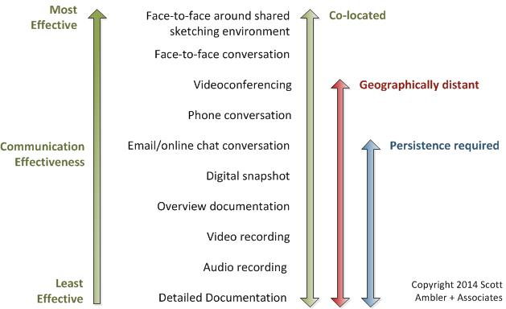
Communication on Agile teams
Image from http://www.agilemodeling.com/essays/communication.htm

Slide 4
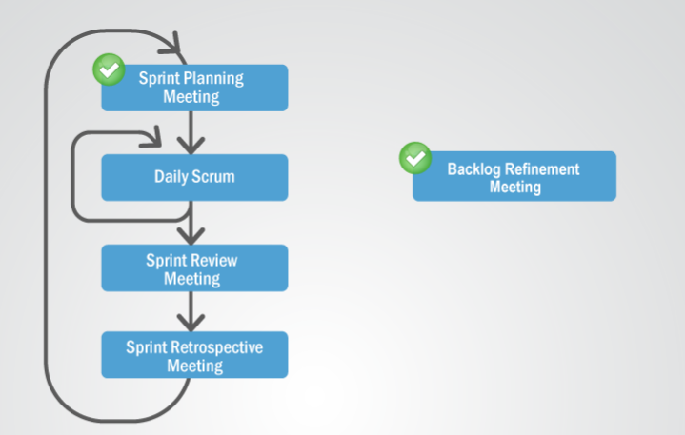
Communication on Agile teams
Possible meeting structure
Image from http://scrumtrainingseries.com/DailyScrumMeeting/DailyScrumMeeting.htm

Slide 5
Communication on Agile teams
Daily SCRUM / Stand-up meetings
Every team member answers the following three questions (assuming meetings occur daily)
  What did I accomplish yesterday?
  What will I do today?
  What obstacles are impeding my progress?

Slide 6
Conflict resolution styles
Avoidance
  One party ignores the conflict
Yielding
  One party allows the other to determine the outcome
Competitive
  The “strongest” party wins
  Assertiveness, arguments, insults, etc.
  Do not use this approach in this class
Cooperation
  Communicate to find a solution acceptable to both parties
  This method is encouraged
Conciliation
  Communicate to find a solution both parties at least can agree to
  Resort to this if cooperation fails

Slide 7
Conflict resolution tips
Practice active listening
  Listener restates or paraphrases what they have heard in their own words, to confirm what they have heard and moreover, to confirm the understanding of both parties
Manage your emotions
  To an extent, this is a skill you can learn and practice
  Isn’t brought up much in science and engineering classes, so you may have to deal with others with low knowledge/experience on this topic
Agree on a conflict resolution strategy BEFORE conflict occurs
  Voting, leaders choose, etc.

